Slide 1

ANALYSIS OF AMAZON CELL PHONE REVIEWS
BY CASANDRA JOSEPHINE FERNANDO

Slide 2
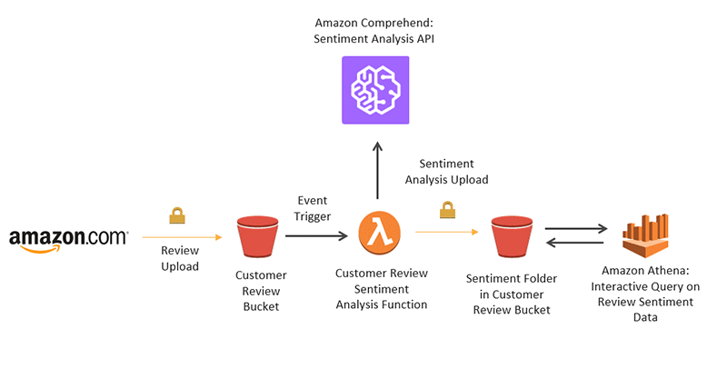

Slide 3
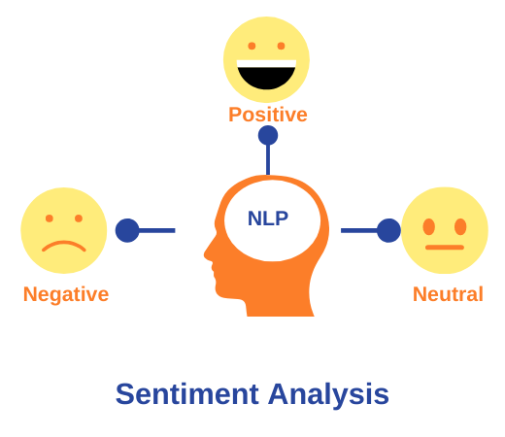
Overview of the project
This project aims at making a model which is used to analyse and predict the reviews given by the customers. I have used NLP for building this model. This helps to analyse the semantic similarity of review text and produces the sentimental [positive or negative] analysis of the review text.

Slide 4
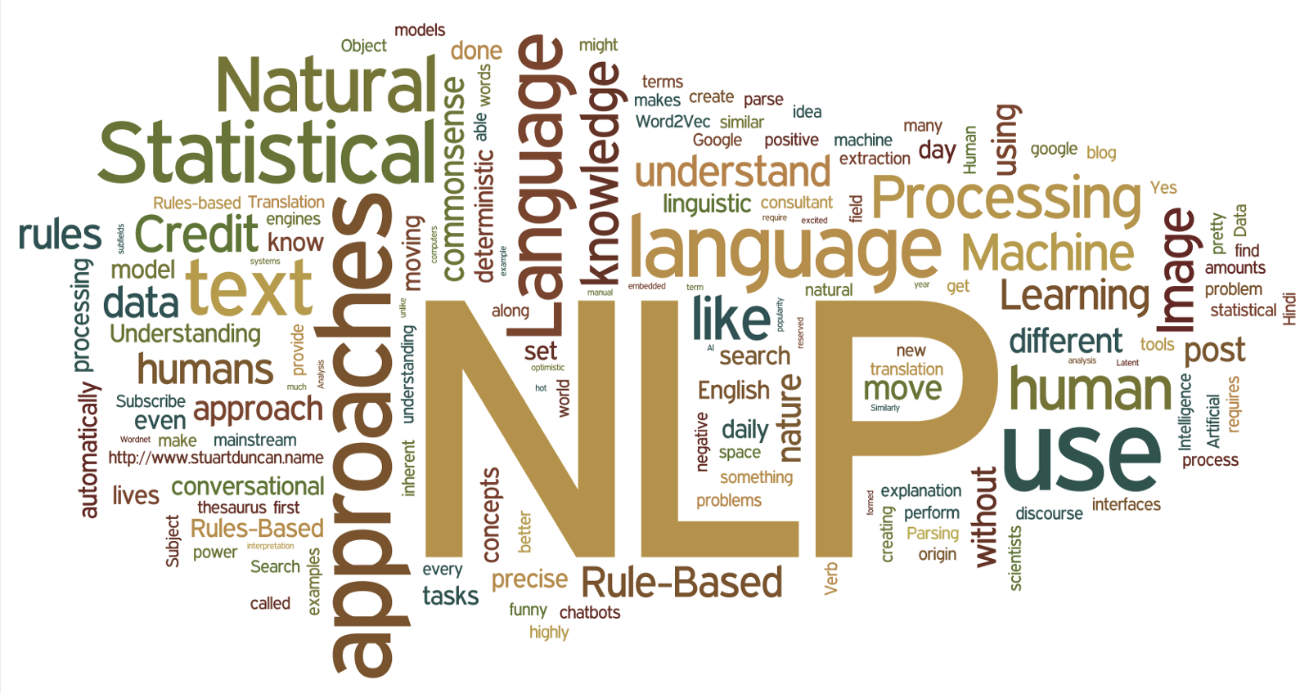
NATURAL LANGUAGE PROCESSING

Slide 5
NLP OVERVIEW
Nat­ur­al Lan­guage Pro­cessing is a field that cov­ers com­puter un­der­stand­ing and ma­nip­u­la­tion of hu­man lan­guage. Natural language processing (NLP) is a field of artificial intelligence in which computers analyze, understand, and derive meaning from human language in a smart and useful way. By utilizing NLP, developers can organize and structure knowledge to perform tasks such as automatic summarization, translation, named entity recognition, relationship extraction, sentiment analysis, speech recognition, and topic segmentation.

Slide 6
Steps involved
Import libraries
Read dataset
Import and download packages
Remove regular expression
Convert text to lowercase
Split text
Stemming
Tokenize the words
Splitting into train and test
Apply ANN steps
Predict model
Save model

Slide 7
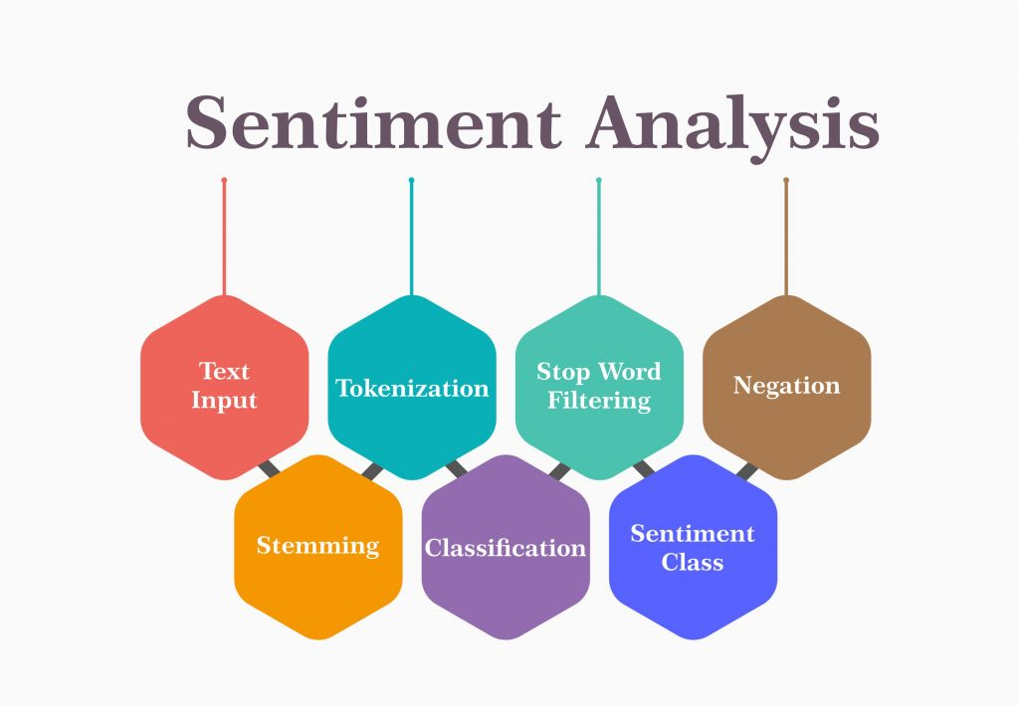

Slide 8
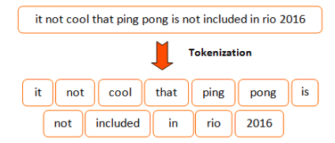
TOKENIZATION

Slide 9
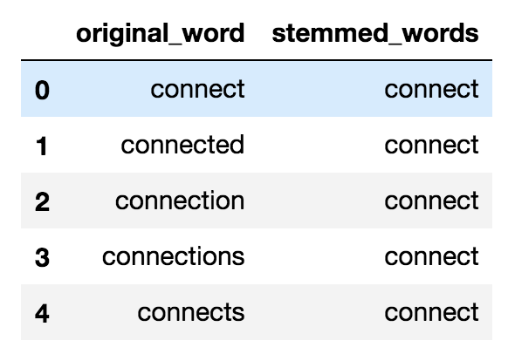
STEMMING
Stemming is basically removing the suffix from a word and reduce it to its root word.

Slide 10
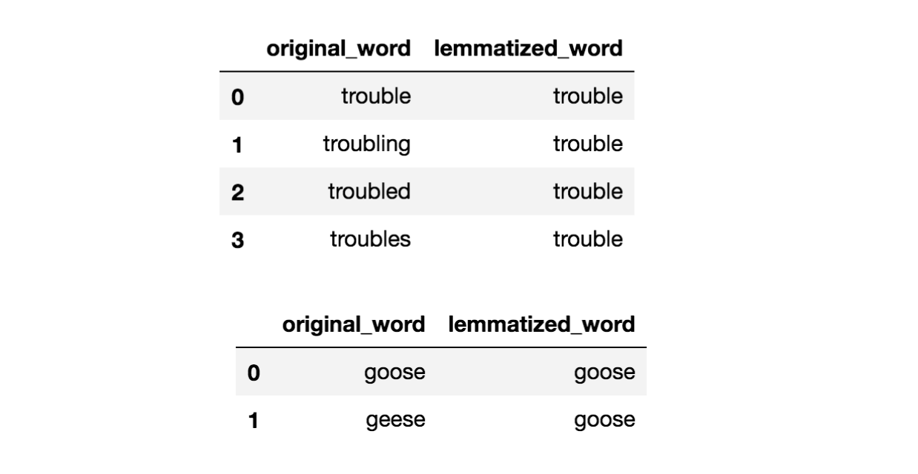
LEMMATIZATION

Slide 11
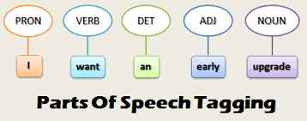
POS TAGS
Part-Of-Speech Tagger (POS Tagger) is a piece of software that reads text in some language and assigns parts of speech to each word (and other token), such as noun, verb, adjective, etc.,

Slide 12
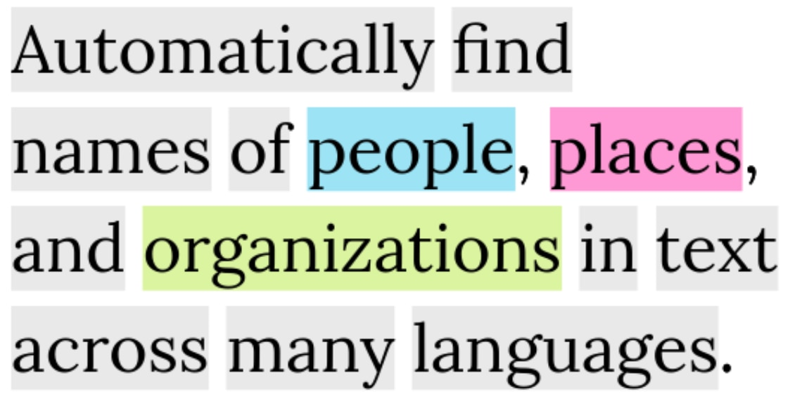
Named entity recognition

